Slide 1
CODEFURY CONTEST
BUG TRACKING SYSTEM
BY TEAM EXCEPTIONS

Slide 2

OUR TEAM
TEAM LEAD – Adithi Satish
Aman Gupta
Abhishek Mandha
Mule Saketh Reddy
Meka Hari Krishna
Potineni Sowbhagya Sree
Twesha Arvind
Mahesh Muthyam
Viswani Edupuganti

Slide 3

Overview
01
02
03
04
Abstract
Introduction
Functional Requirements
Software Architecture
05
06
07
User Interface
Data flow Diagram
ER Diagram

Slide 4
Abstract
This project presents the development of an online bug tracking system designed to streamline the process of identifying, reporting, and resolving software bugs across various development projects.
The application caters to different user roles Project Managers, Developers, and Testers offering role-based access and functionalities to ensure efficient bug management and project tracking. Key features include user management with role-specific dashboards, project creation and team assignment, detailed bug reporting and tracking, and severity-based prioritization. The system also allows for sorting and filtering bugs, assigning bugs to developers, and updating bug statuses.

Slide 5
Introduction
An online bug tracking system provides a centralized platform for managing bugs, enhancing communication, and fostering collaboration among various stakeholders involved in a project, such as Project Managers, Developers, and Testers.
This bug tracking system aims to streamline the process of bug reporting, assignment, and resolution. By offering role-based access, the system ensures that each user can perform tasks relevant to their responsibilities. Project Managers can create projects, assign team members, and monitor all bugs associated with their projects. Testers can report bugs and track the status of bugs they have reported, while Developers can view and update the bugs assigned to them.
Ultimately, this bug tracking system is designed to support software development teams in maintaining high standards of software quality, reducing time to market, and improving the user experience by ensuring that bugs are addressed promptly and effectively.

Slide 6
Functional Requirements
User Management
User Registration: The system must allow new users to register with the required fields, such as username, email, password, and role (Project Manager, Developer, Tester). Validation must be enforced for all fields.
User Login and Authentication: The system must validate user credentials to allow access. Only authenticated users can access the application.
Role-Based Access Control (RBAC): Each user must have access to features specific to their role:
Project Managers: Can create and manage projects, assign bugs, and view all bugs.
Developers: Can view bugs assigned to them and update bug status.
Testers: Can report new bugs and view bugs they have reported.
Project Management
Create New Project: Project Managers can create new projects by specifying details like project name, start date, and team members.
Project Assignment: The system should allow assigning team members (Developers and Testers) to projects with role-specific constraints:
Developers can be assigned to only one project at a time.
Testers can be assigned to a maximum of two projects.
Project Managers can manage a maximum of four projects.
01
02

Slide 7
Functional Requirements
Bug Management
Report a Bug: Testers can report new bugs by providing necessary details like project name, title, description, severity level, and more. The bug must be associated with an active project ("In Progress" status).
Bug Assignment: Project Managers can assign reported bugs to Developers.
Update Bug Status: Developers can update the status of bugs assigned to them (e.g., "In Progress," "Closed").
Bug Tracking: The system must maintain a history of all actions taken on bugs, including status changes, assignees, and comments.
01
02

Slide 8
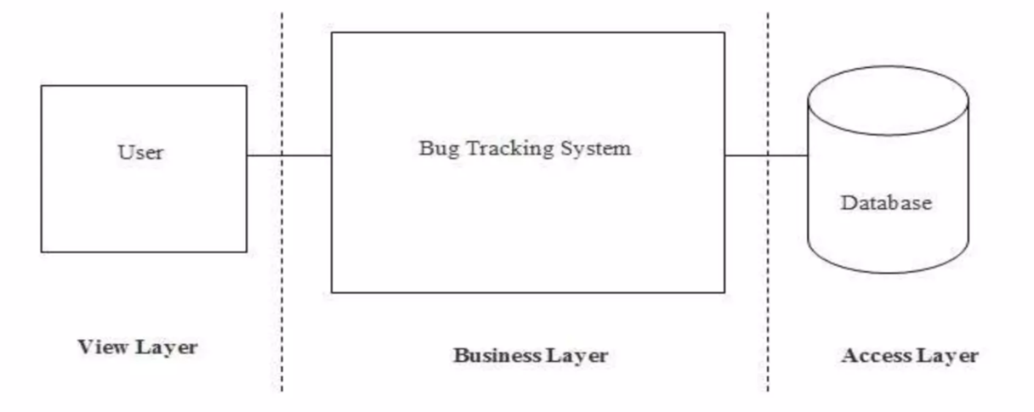
SOFTWARE ARCHITECTURE

Slide 9

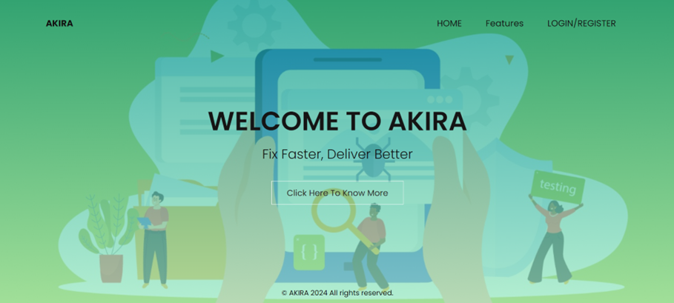
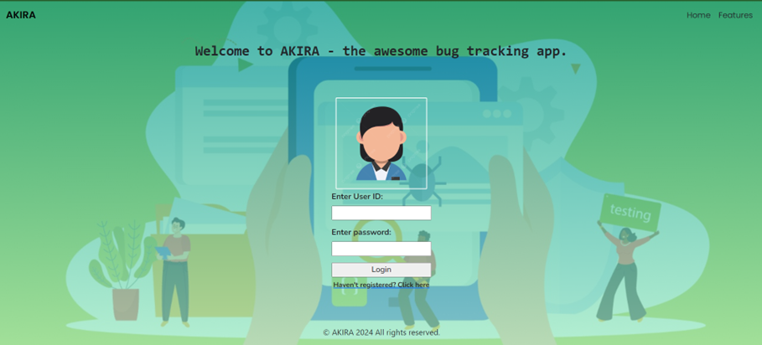
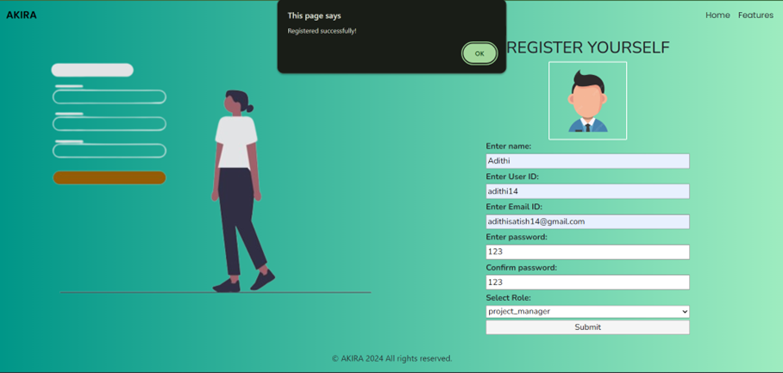
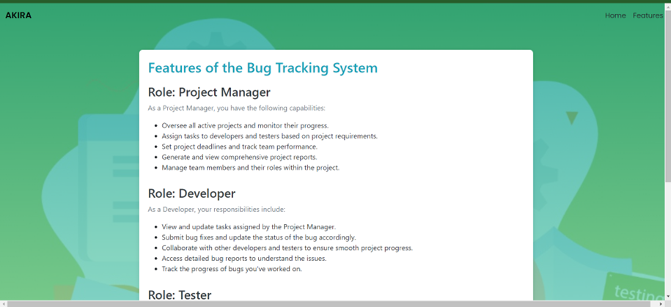
USER INTERFACE
Home page
Login page
Successful Registration
Features Page

Slide 10
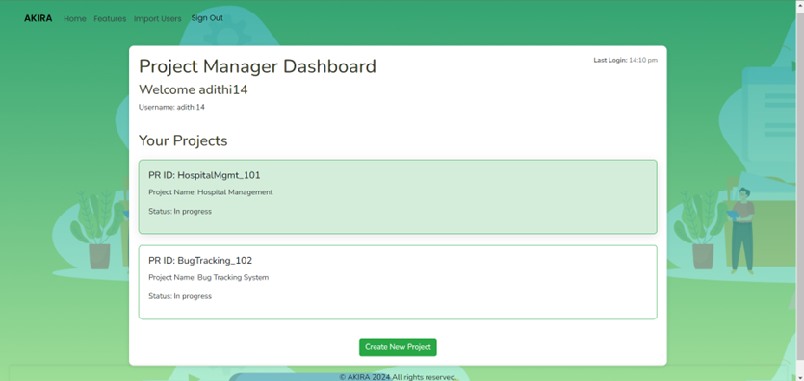
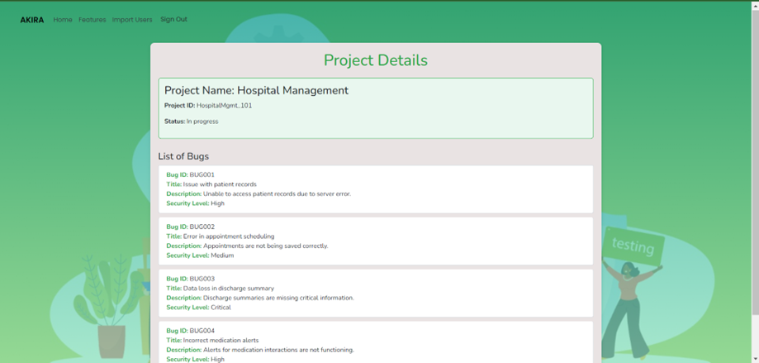
Project Manager Dashboard
Project Details

Slide 11
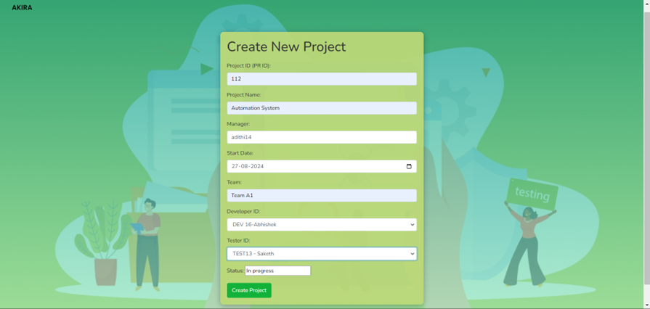
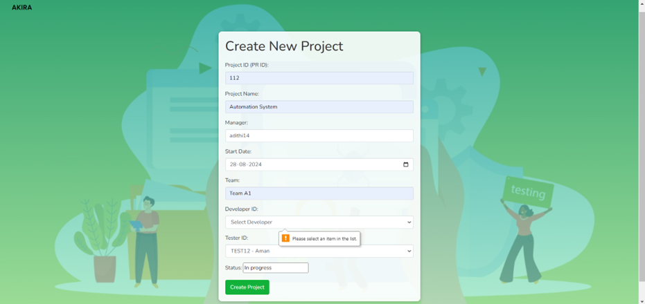
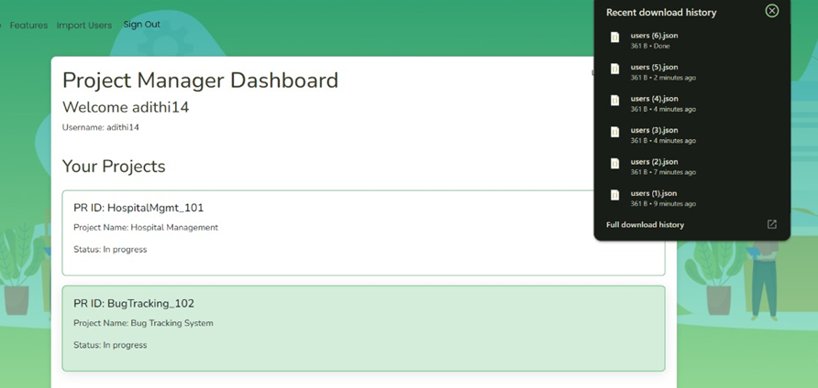
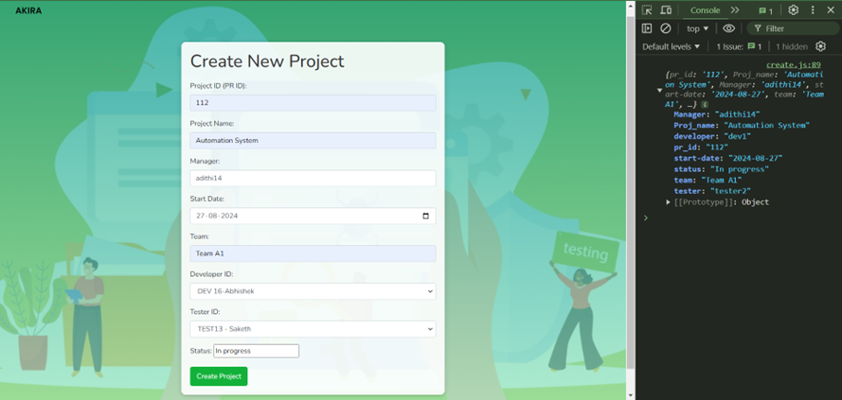
Project Details
Create new project
Creating new project with validation
import users will result in downloading a json file
Create project with console output

Slide 12
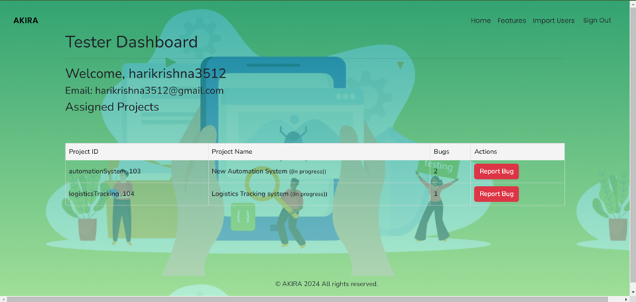
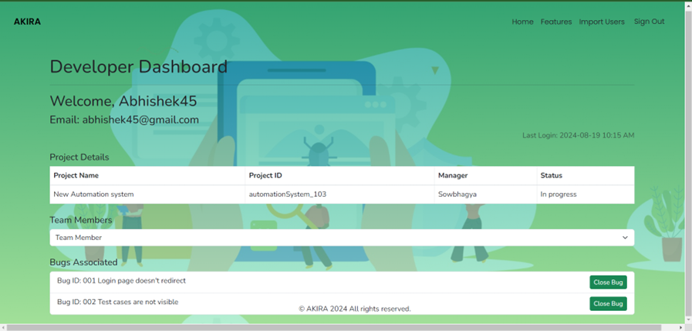
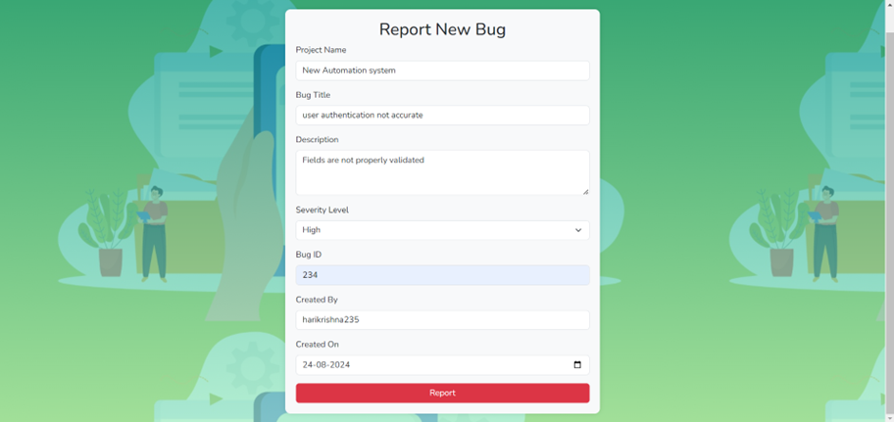
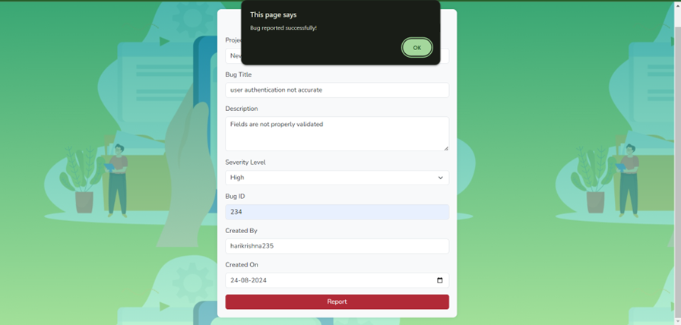
Developer Dashboard
Tester Dashboard
Report new bug
Bug report success

Slide 13
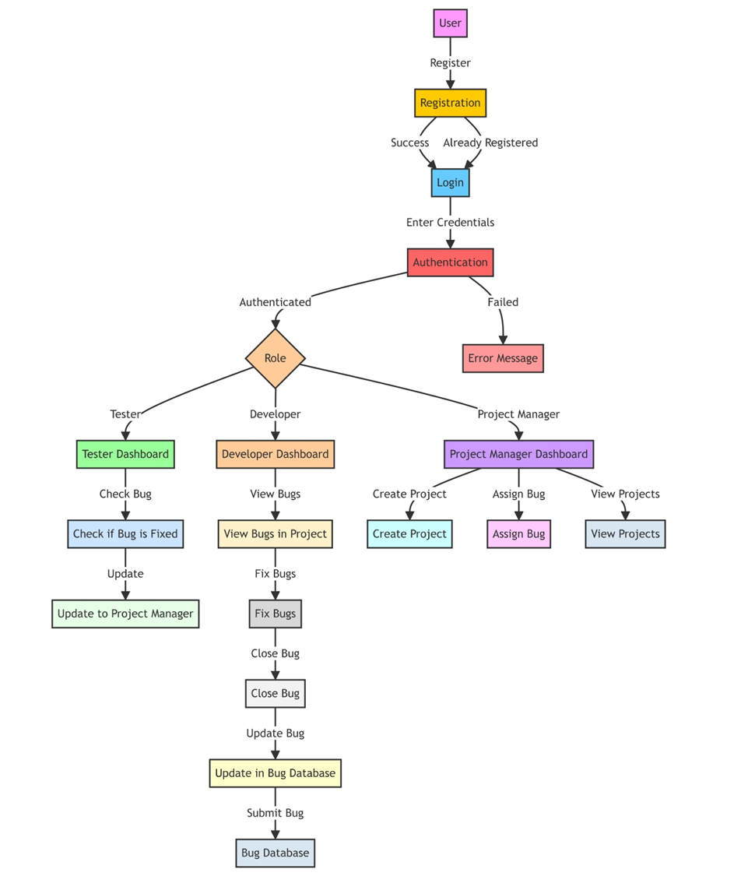
DATA FLOW DIAGRAM

Slide 14
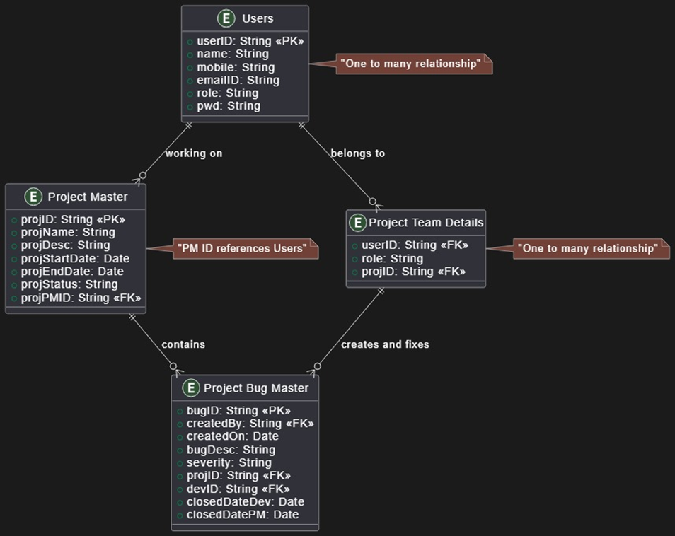
Entity Relationship Diagram

Slide 15
Thank You!

